Slide 1

Exploration Through Virtual and Augmented Reality
Team Members :
Vaibhav Goyal (19)
Radhika Raghuwanshi (54)
Rohini Yedelli (77)

Slide 2

Introduction To Augmented and Virtual Reality :
Virtual Reality is a computer simulated reality which replicates a real environment, and simulate a user's physical presence in this environment while,
Augmented Reality blurs the line between what's real and what's computer-generated by enhancing what we see, hear and feel.

Slide 3
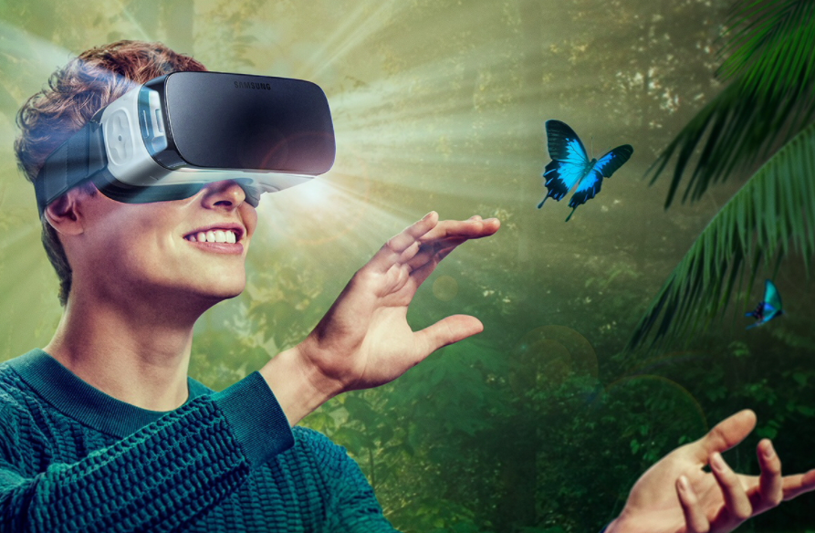
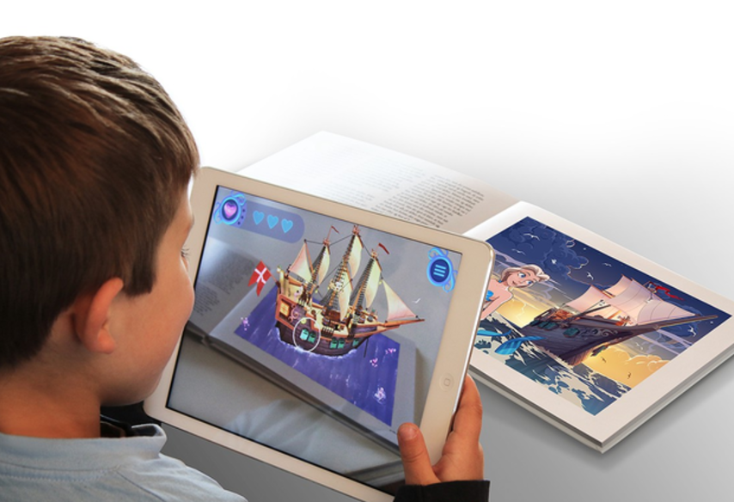

Slide 4
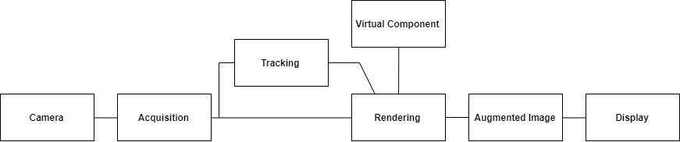
Architecture of Augmented Reality

Slide 5

Project Objective
The objective of the project is to find what can be the applications of Virtual Reality and Augmented Reality in the field of Education. Hence, to build different applications that will give interactive and immersive learning experience.

Slide 6

Project Idea
1. Cube Problem
2. Wonders of the world
3. Engineering Drawing
4. Story Telling

Slide 7

Hardware/Software Requirements
Unity3D (Personal edition)
Vuforia
C#
VR Headset
Smartphone with Gyroscope and Magnetometer
sensor

Slide 8

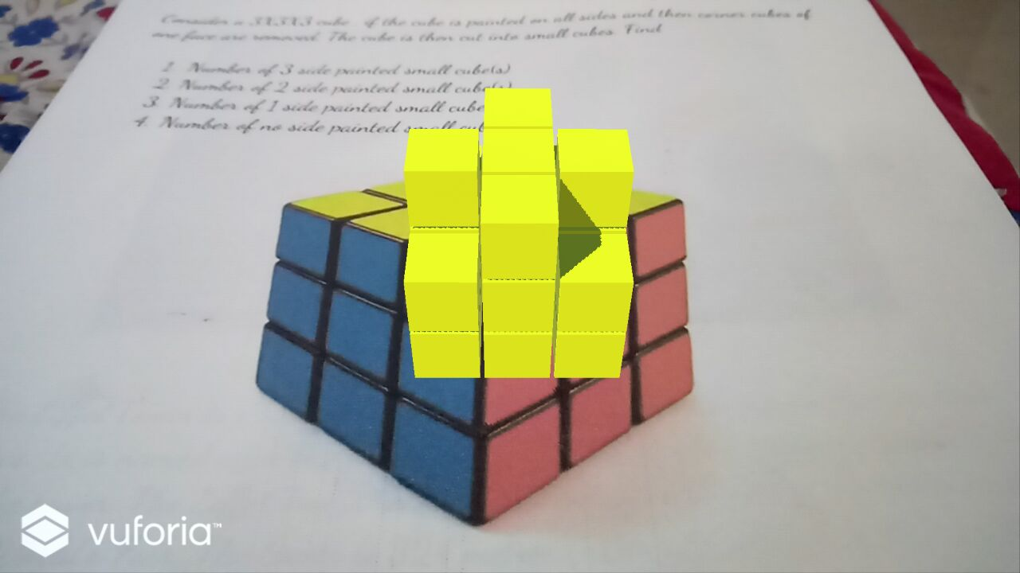
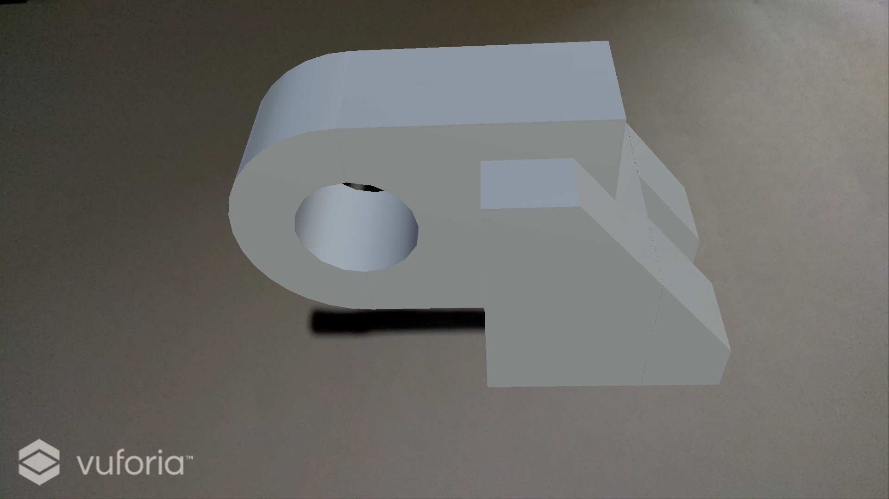
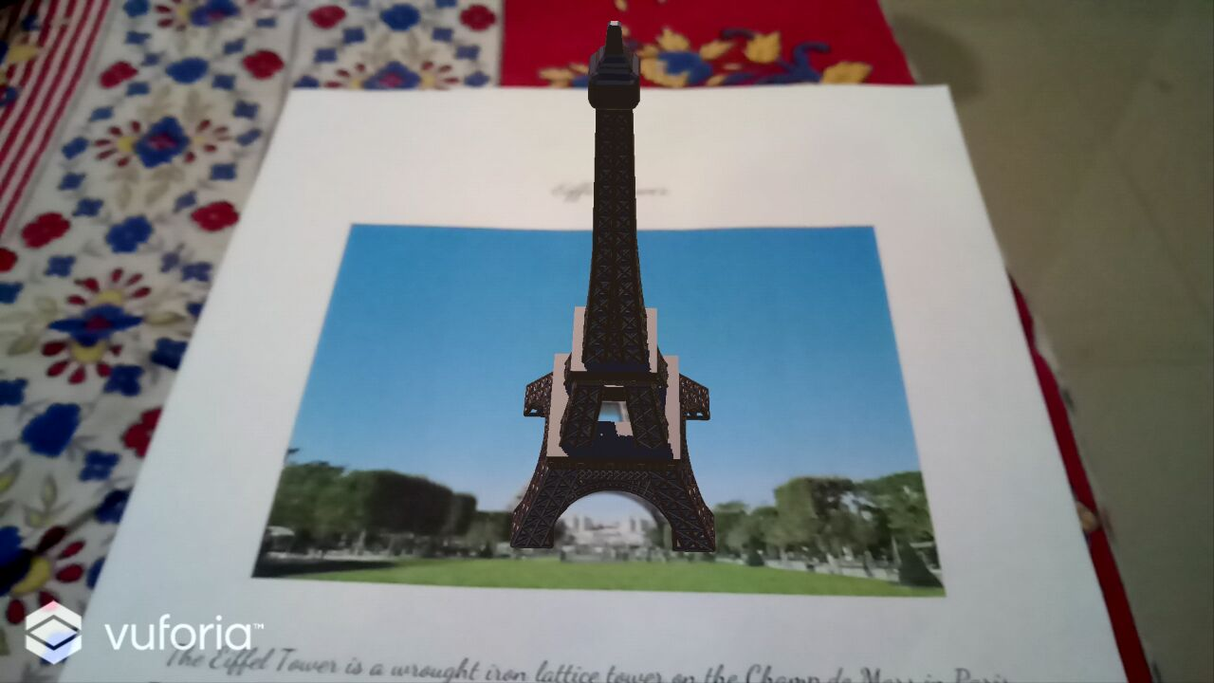
Project Outcomes

Slide 9
Thank You

